Slide 1


Dancing with Docker images in Azure DevOps
Karthikeyan Govindaraj
Supported by the Russian MVP Сommunity

Slide 2


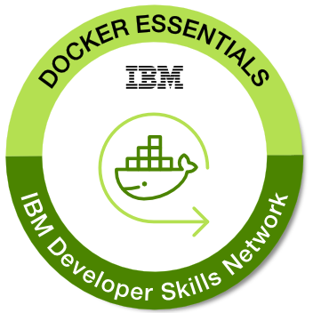
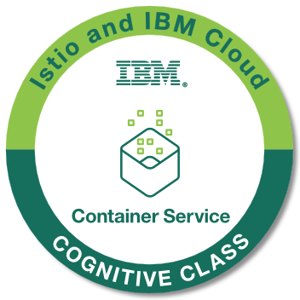
About me
Karthik is a CNCF Speaker, DevOps Architect and Cloud Native App Developer who is passionate about Cloud and Cloud-Native Infrastructure, Developer Tools & Experience and Open-Source Enthusiast.
He is also a passionate writer who writes about the technologies and technology challenges.
Know more about me!!!

Slide 3
Containerizing and deploying multiple instances of an app that talks to one variant of a database per instance.
Connecting to Oracle, the app needs oracle-based drivers installed in the OS
Connecting with Sybase, its dependency lib must be available
Pretty much rest is universal viz., MySQL, MSSQL, PostgreSQL etc
Problem Scenario

Slide 4

What can we do?
Approach 1:
Pre-install all the drivers viz., Sybase, Oracle in the base image.

Slide 5
Approach 1
Oracle Libs
Universal Drivers
Base Image: Alpine
Sybase Libs
Functional Code
Functional Code: ~xyz GB
So we are not going to choose this approach.
As this violates the smaller image size policy; which will create hassle in
Maintenance
Security
Performance
Efficiency
Oracle libs: X + Y + Z + 2.5MB
Sybase libs: X + Y + 2.5MB
Universal drivers: X + 2.5MB
Only Base image, alpine:latest 2.5MB

Slide 6
What can we do?
Approach 2:
Create as much as repositories with the same functional code with diff image construction logic.

Slide 7

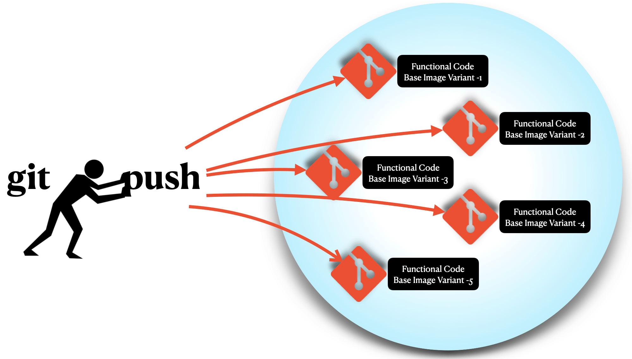
Approach 2
Functional Code +Base Image+Sybase
Functional Code +Base Image+Variant n
So we are not going to choose this approach as well.
As this duplicates the code in multiple repositories and violates the source of truth policy for the functional code.
Functional Code with Base Image
Functional Code +Base Image+Oracle

Slide 8
Bonus Golden Option
Docker allows user to pass arguments during build time.
Azure repositories allows to trigger one repository’s pipeline from another.
Azure pipeline jobs can be run in host or in containers.
Azure variables can be used to hold data between pipeline jobs.
Containers provide isolation from host and allow you to add tools and dependencies for build.
Azure Pipelines allows to use repositories as resources to define reusable content, logic, and parameters.

Slide 9





… contd.,
Create a repository with Functional Code.
Create Dockerfile in the Functional Code repo with universal drivers and a build argument for base image; defaults to alpine:latest.
Create a separate repository for Oracle dependencies installed base image.
Create a separate repository for Sybase dependencies installed base image.

Slide 10


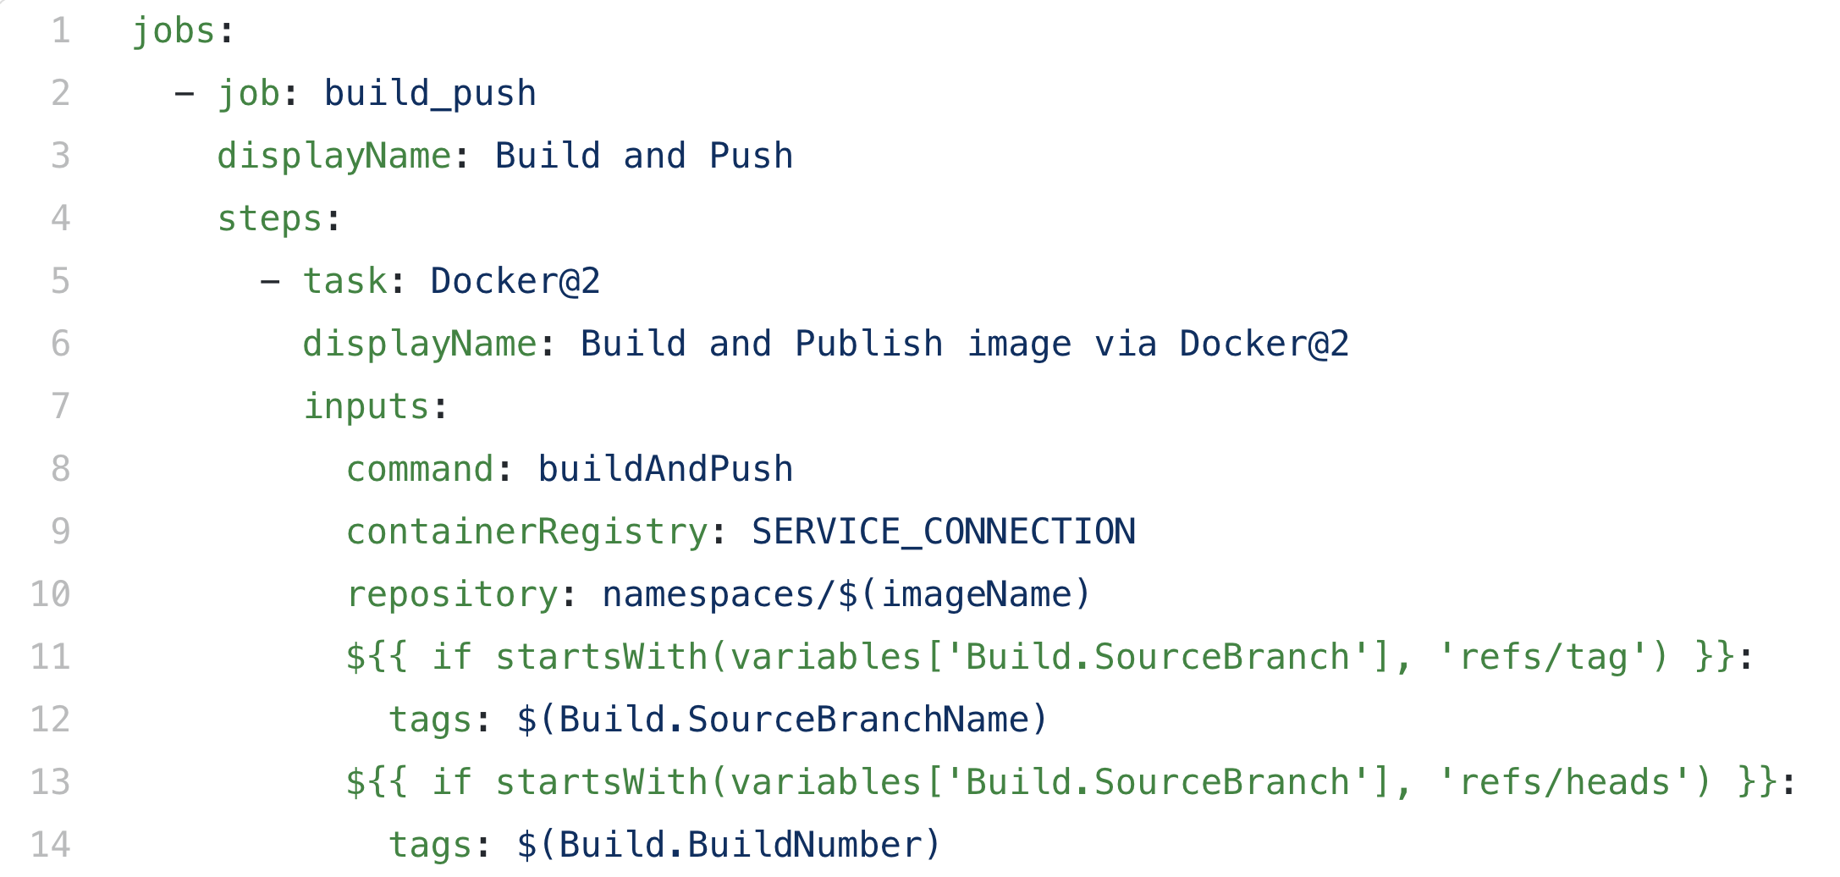

docker.yml in ci_templates repo
Docker build template
Need to build docker images for all the repositories.
Re-use docker image build logic using repositories as resource in Azure Pipelines.

Slide 11
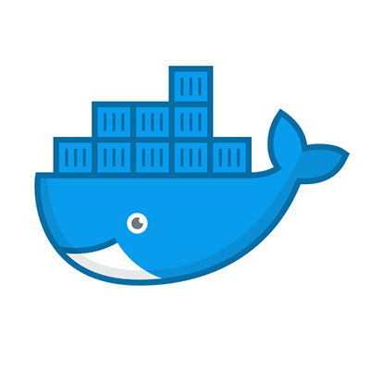
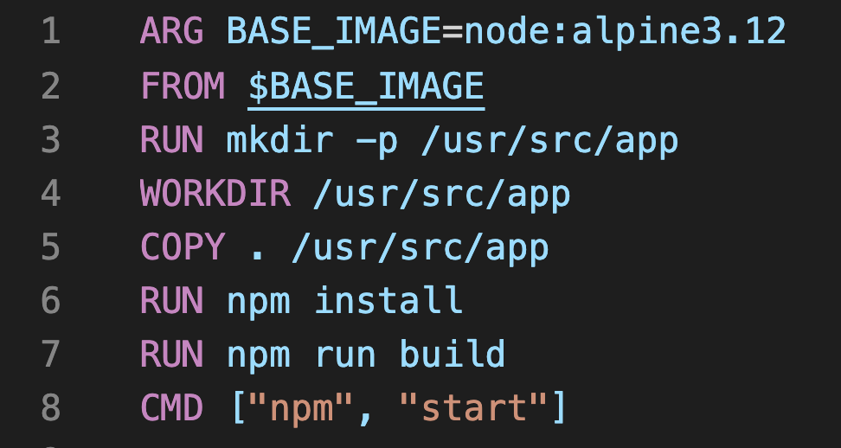
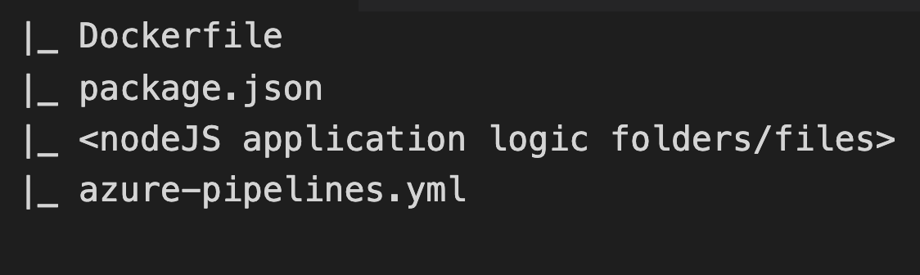
Generic App
Create a repository named generic-app and check-in all the functional code.
Create a Dockerfile for the repository with build arguments for the base image defaulting to alpine.

Slide 12
Variables can hold the values that needs to pass across pipelines.
Variables can be grouped into Variable Groups and access restrictions can be applied on it.
Azure Pipelines also provides pre-defined variables that holds the pipeline scope values.
Reg-ex can be employed to evaluate a pre-defined and user-defined variables.
Azure Variables / Variable Groups

Slide 13
… contd.,
Admin Variables
We will store the PAT in AZURE_DEVOPS_CLI_PAT variable under Admin Variables group.
This is used to authorize the triggers.
Also used for Azure DevOps CLI login.
Platform Variables
This is used to store the latest tag information of all the repositories.
In Scope Variables:
We will also assign the image name in imageName variable.
Determine whether the pipeline is triggered by main branch or a tag and store binary value in isMain and isTag.

Slide 14
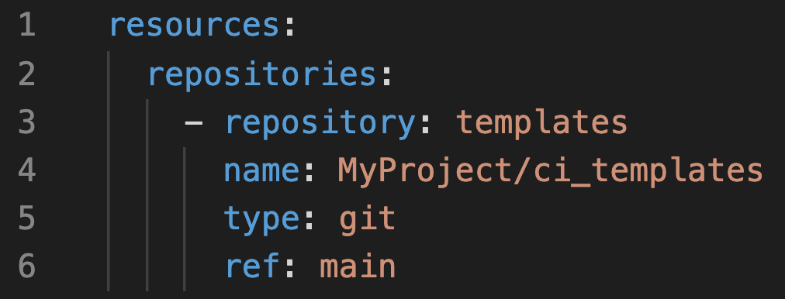

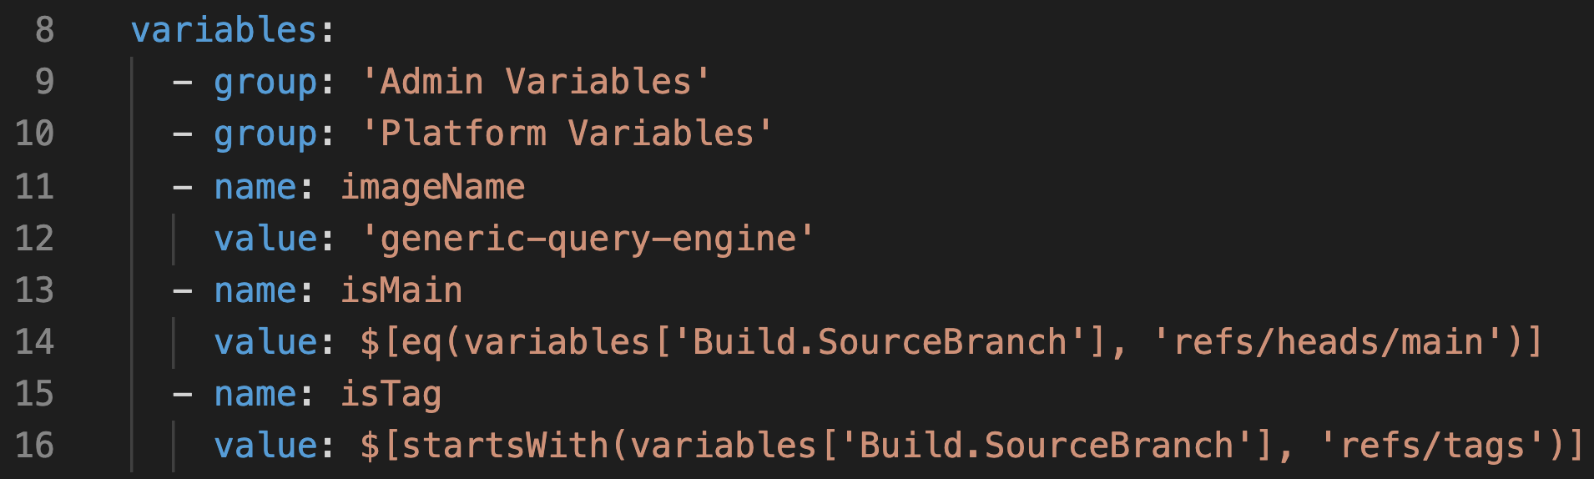

Let’s build Azure Pipeline
Import the ci_templates repository as a resource in generic-app
Import all the variables and variable groups

Slide 15


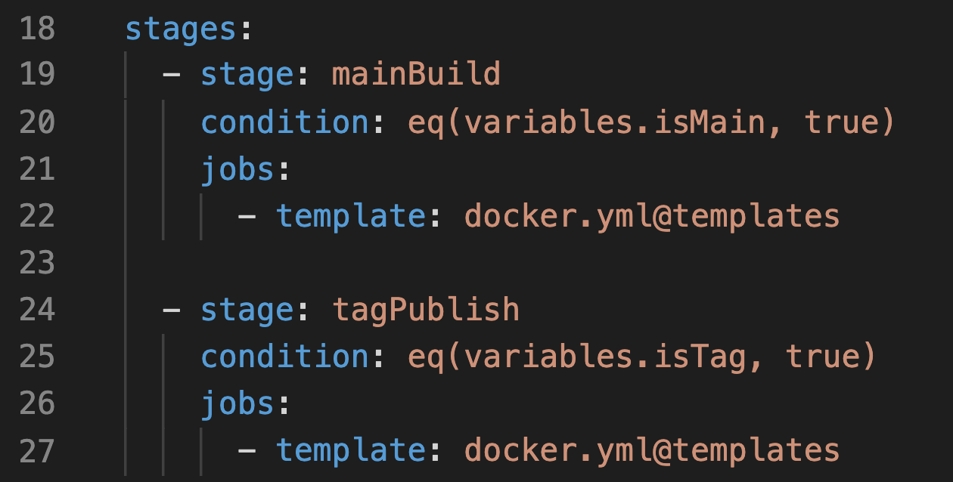
… contd.,
Stages are the major divisions in a pipeline. Jobs are organized into stages.
Let’s define two different stage for main branch and tag build.
Define a dedicated stage for updating the Platform Variables group’s tag value for the current repo.

Slide 16
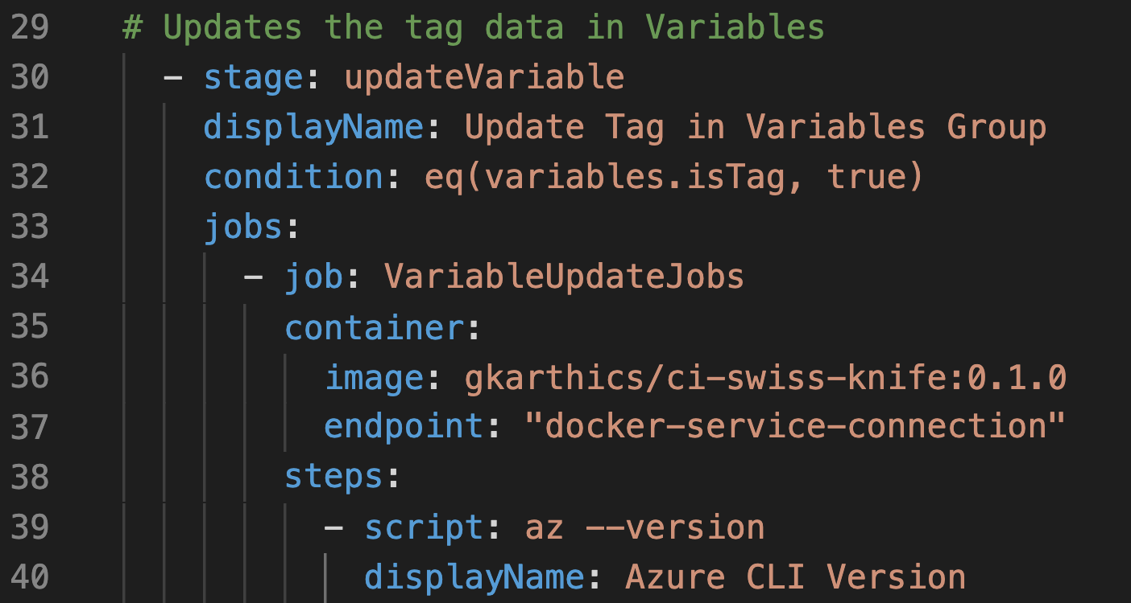

Variable update stage
A job is a series of steps that run sequentially as a unit.
Using container job, since we need Azure CLI.
ci-swiss-knife image

Slide 17
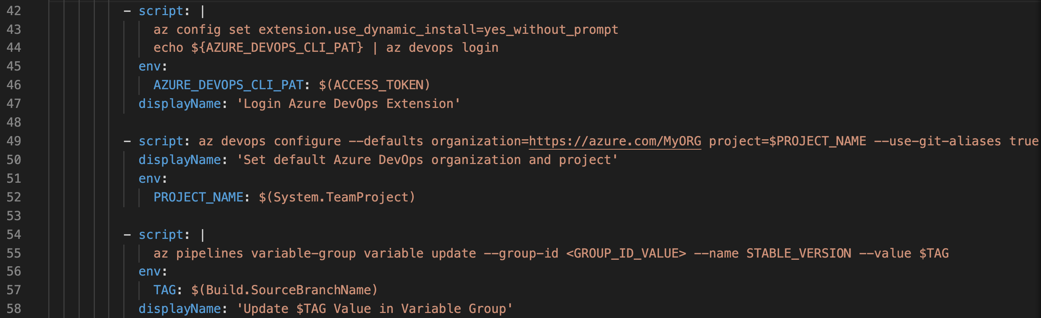




… contd.,
Configure Azure CLI
Login to az devops via PAT
Set the defaults
for
organization,
project etc.
Update the
variable for latest tag value.

Slide 18
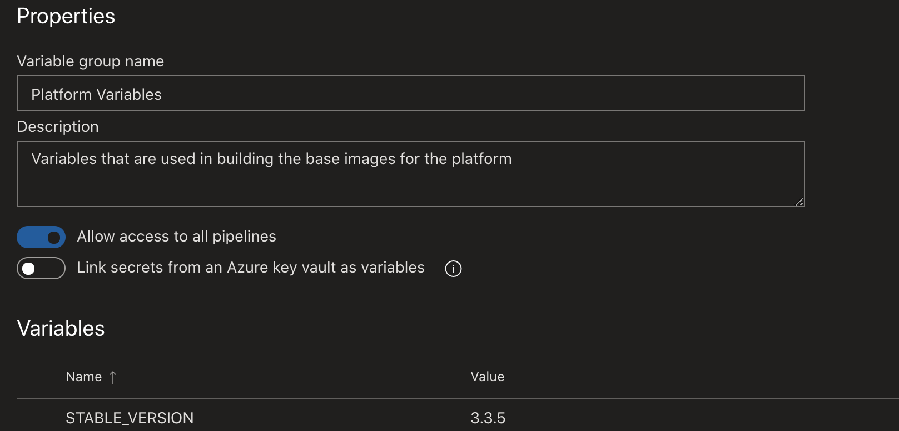

Slide 19



Build an image with Oracle Libraries that can be used as base image.
Pass the built image as argument to functional repo generic-app
Trigger the pipelines.
Oracle base variant

Slide 20
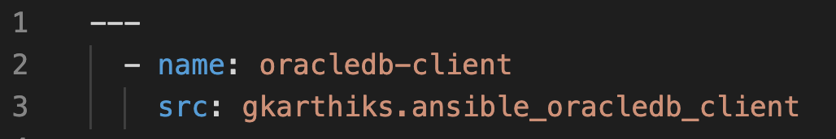

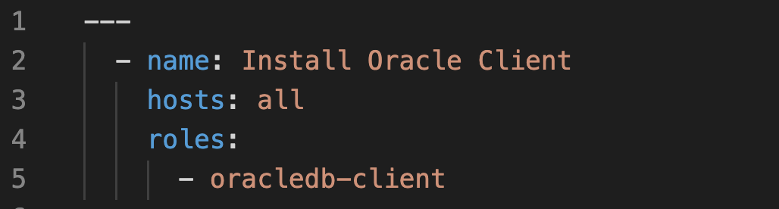
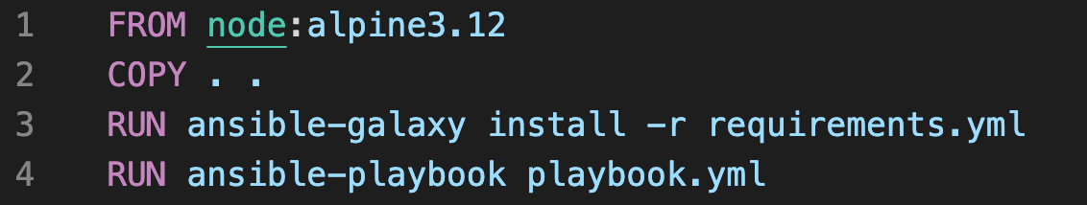
… contd.,
Using Ansible, define requirements.yml and playbook.yml to use the existing role ansible_oracledb_client
Define docker steps to execute Oracle dependencies via Ansible

Slide 21

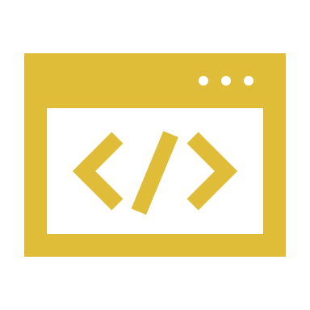
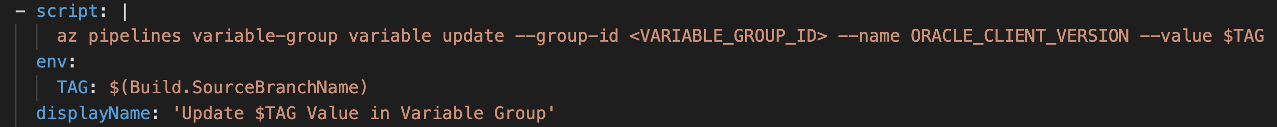
… contd.,
Similar to the generic-app we will create the oracle-client image with azure pipelines.
Update the latest tag value in the variable ORACLE_CLIENT_VERSION

Slide 22


~
Sybase base variant
Similar to Oracle, create a independent repository for Sybase base image as sybase-client
Create a Dockerfile to install the Sybase required dependencies via Ansible playbook.yml file
Using azure pipelines, trigger when a tag is dropped in the sybase-client repo
Update the latest tag info for the Sybase variable

Slide 23
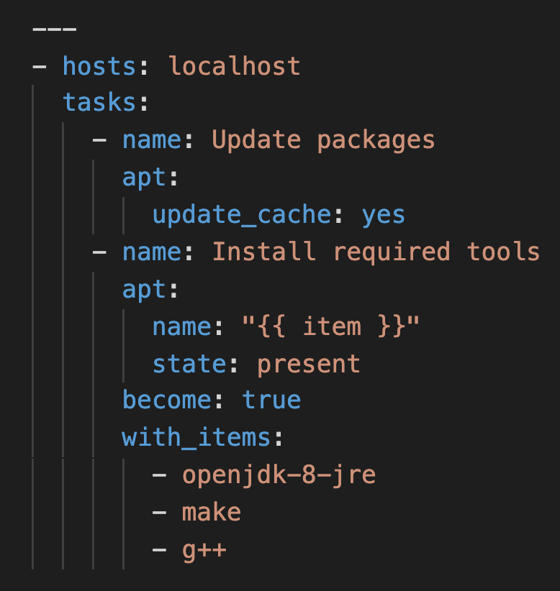
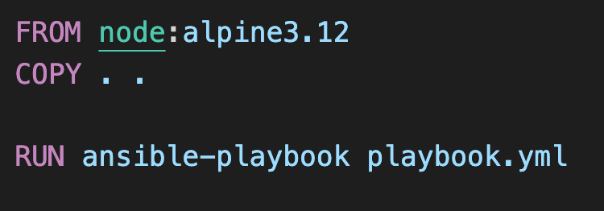
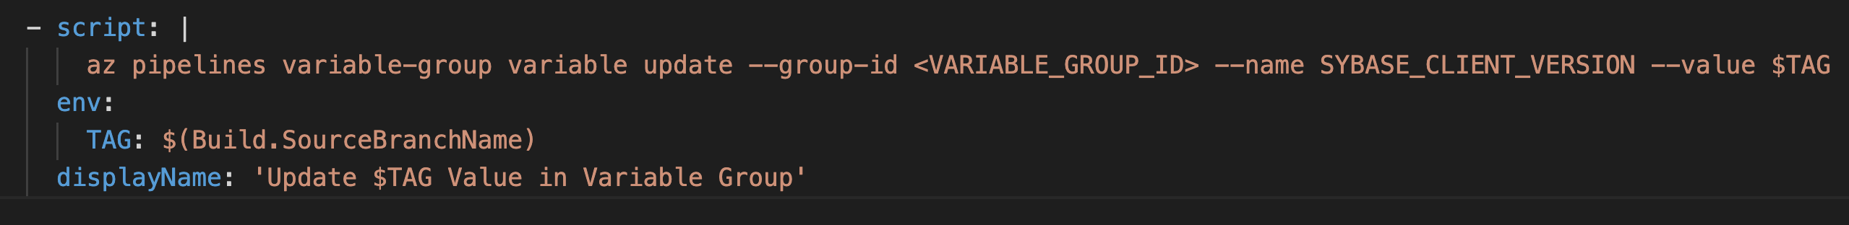
… contd.,
The ansible playbook with Sybase required dependencies are defined as
The Dockerfile for executing the ansible playbook would simply like as shown

Slide 24



Accomplished so far
generic image with functional code and alpine base
only a base image for Oracle platform dependencies
only a base image for Sybase platform dependencies
Things to do
add functional code on Sybase and Oracle
make triggers automated
identify the source of trigger
Pipeline Triggers

Slide 25
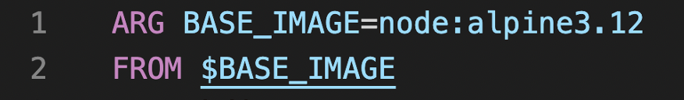



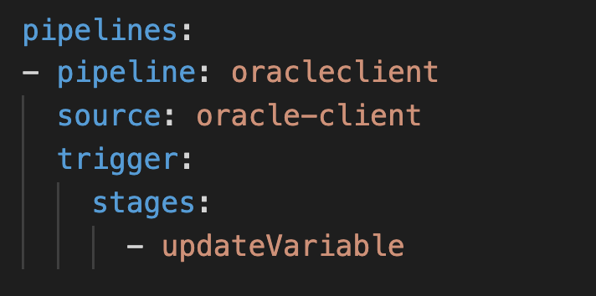
… contd.,
Remember the build argument in the generic-app repo’s Dockerfile
All we have to do is pass the Sybase and Oracle base image with a trigger from the corresponding repo
Azure provides a way to add pipelines as a resource
Let’s start with the Oracle trigger

Slide 26

… contd.,
The generic-app pipeline will be triggered soon after the successful completion of the stage updateVariable in the oracle-client repo.
Triggers the default branch.
We need a specific build as we want to flip the base image.
Let’s add a variable to evaluate the trigger source.

Slide 27
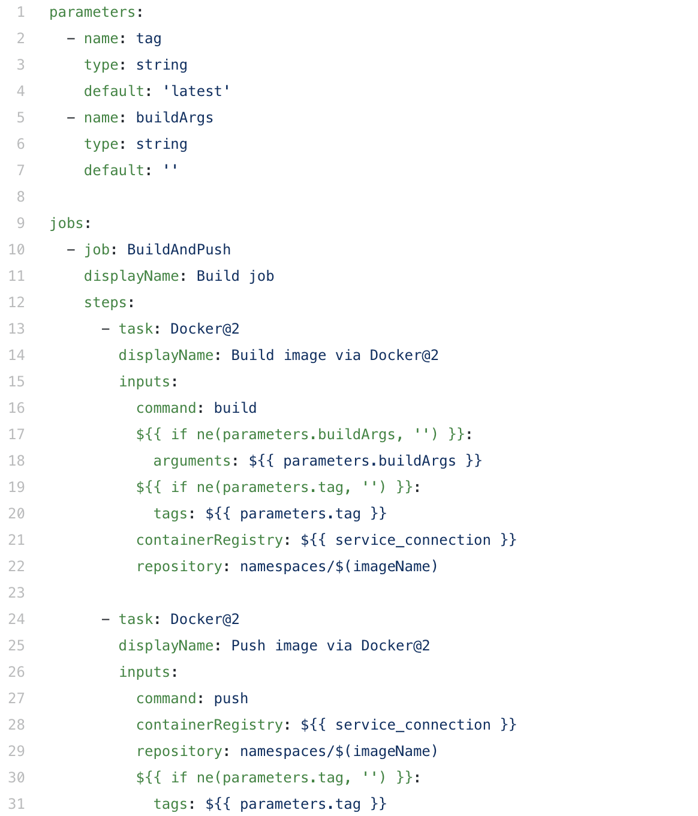

… contd.,
Let’s use the isOracleTrigger to exclude unnecessary main build.
Create another docker build template which accepts the build arguments and tag differently and save it as upstream-docker.yml
This can be re-used for Sybase as well.
upstream-docker.yml in ci_templates repo

Slide 28
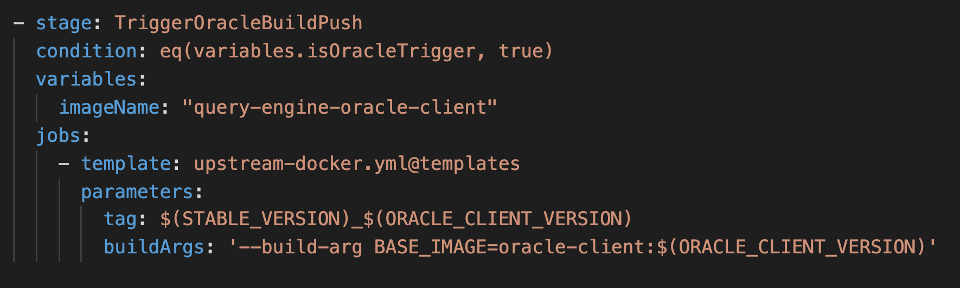
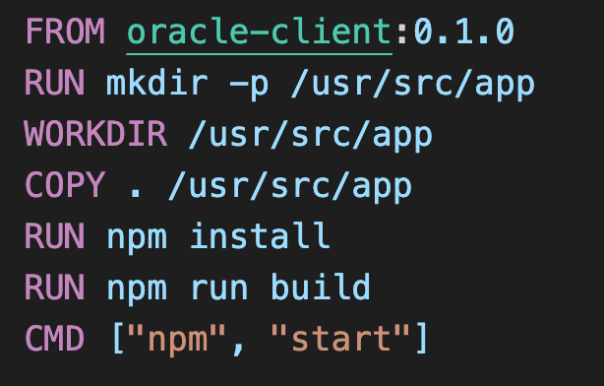
… contd.,
Define a stage exclusively for oracle-client pipeline triggered run
The resulting to-be executed Dockerfile for this will be

Slide 29
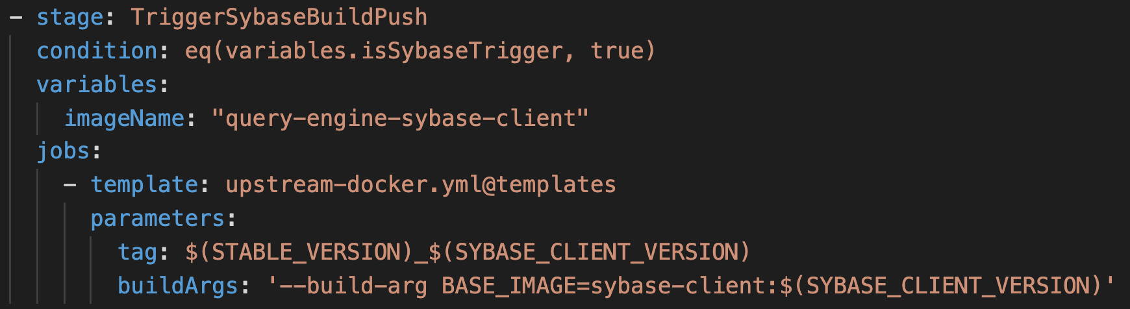
… contd.,
To trigger the sybase-client base variant, everything is similar to Oracle.
Define a variable to evaluate the trigger source

Slide 30
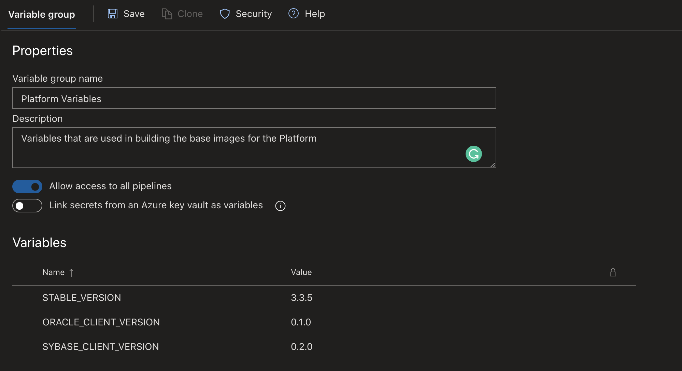
… contd.,
The final variable group will look something like below with all the STABLE_VERSION, ORACLE_CLIENT_VERSION and SYBASE_CLIENT_VERSION with its values updated.

Slide 31



… contd.,
The discussed process is a one-way trigger from different base to build the image.
The vice-versa can also be set to build all the variants if there is a change in any of the functional code.
This will make flipping base images of the docker file more automated and preserve the single source of truth and smaller image size polices.

Slide 32
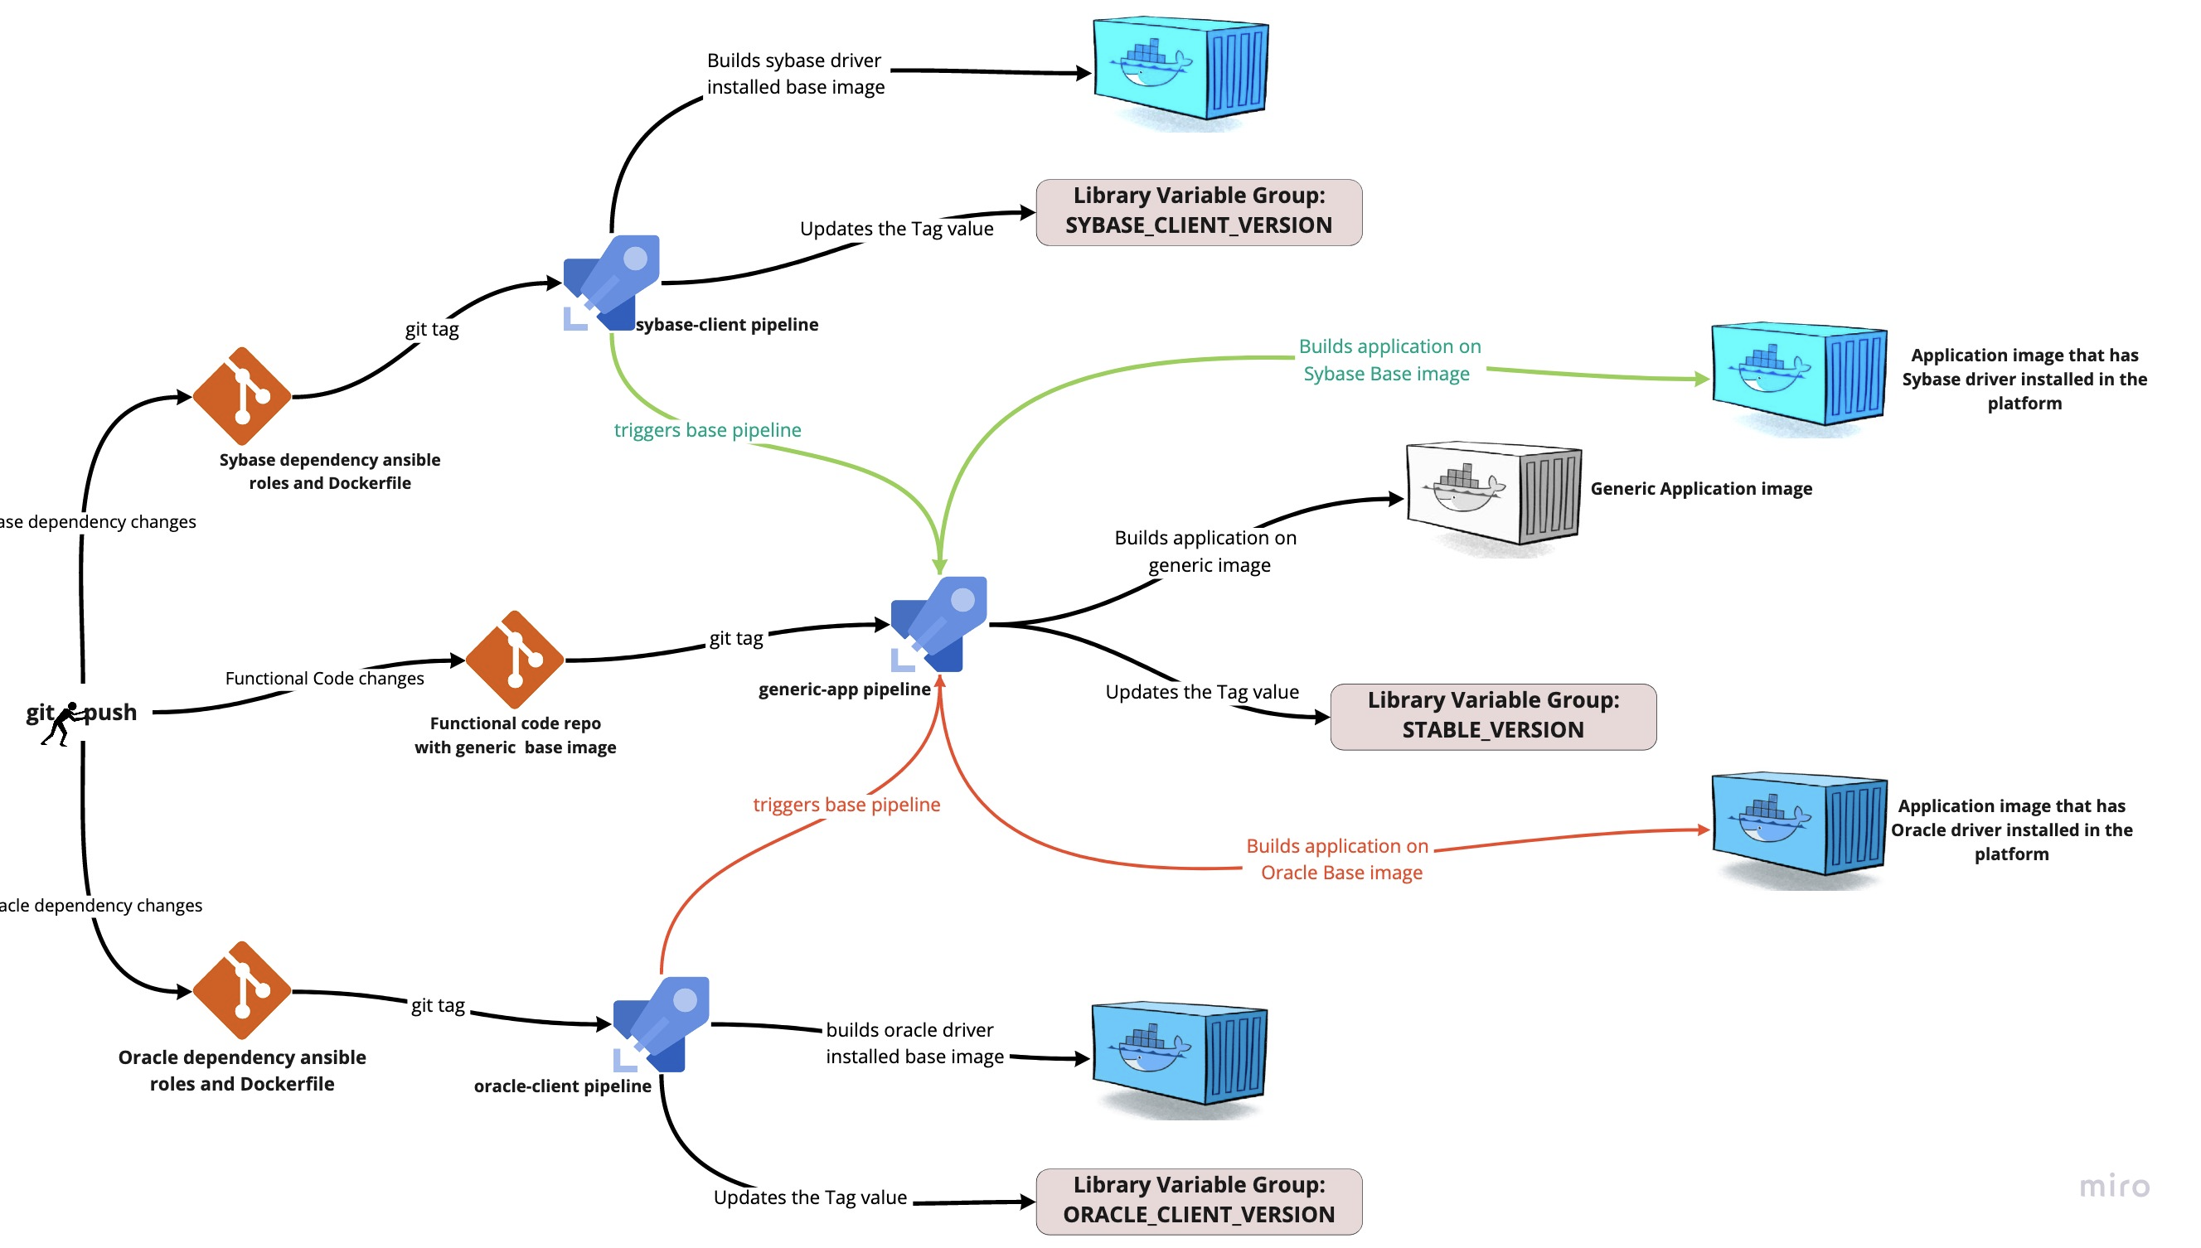

Slide 33


Thank You !!!
Medium article
Supported by the Russian MVP Сommunity

